Slide 1

Data Elimination 101

Slide 2
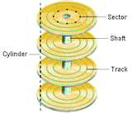
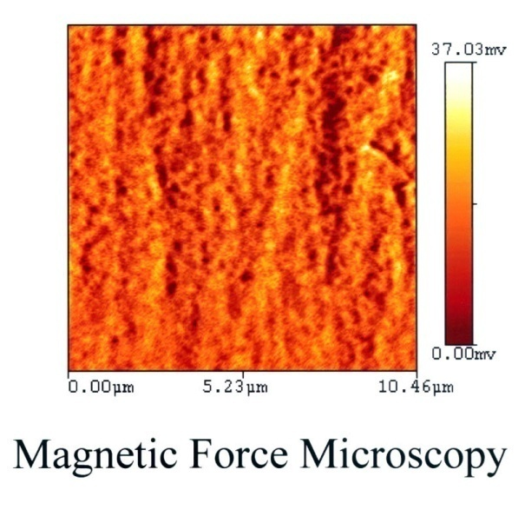
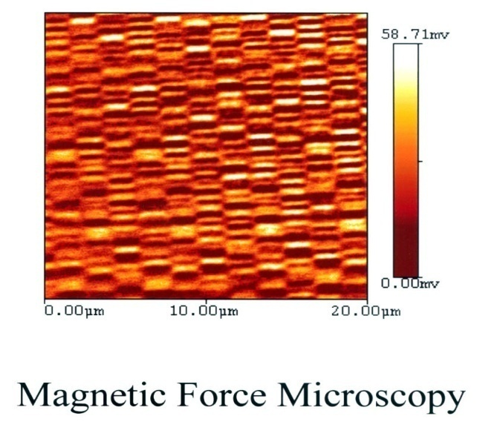
What Does Degauss Mean?
Computer hard drives use magnetic fields to store data on special discs called platters.
Degaussing is the elimination of a magnetic field patterns.
A degausser of the appropriate strength will eliminate the magnetic fields on the hard drive platters eliminating all data.
Before
After

Slide 3
Why Degauss?
Computer hard discs are made to be robust storage systems
Removing data from a hard drive can be very difficult as it was designed to have many methods of retrieval
Anyone can send a drive to a recovery company and have the data retrieved from it
Manufacturers of hard drives engineer retrieval methods into the design

Slide 4
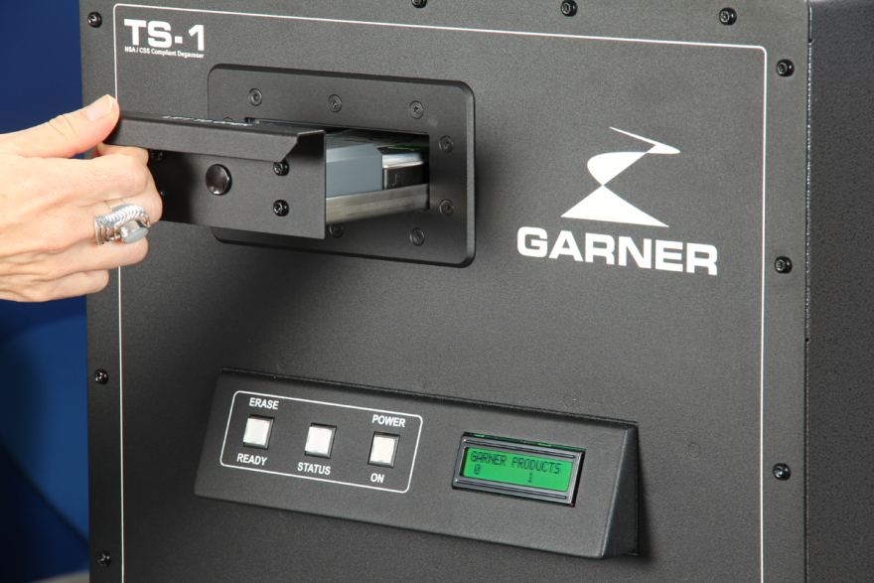
How Does a Degausser Work?
Pulse degaussers like the TS-1 degausser use a large coil that the media passes inside of and the pulse is just for a fraction of a second. The high energy magnetic field is focused inside the coil and an insignificant amount is emitted outside of the machine.

Slide 5
Magnetic Exposure
According to the American Conference of Governmental Industrial Hygienists (ACGIH) Threshold Limit Values (2005) - Static Magnetic Fields, whole body exposure limit recommended for an 8 hour shift is 600 gauss.
Because of the short duration of each pulse from a pulse degausser (1/20th of a second) and the extremely small magnetic field outside of the degausser (<6 gauss, AOD), the total 8 hour whole body exposure is 0.004% of the recommended limit.
AOD = Average Operating Distance

Slide 6
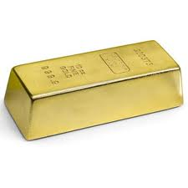
End of Life Cycle Plans
Each company should have a plan developed to dispose of electronic media
Improper disposal can cause legal problems as well as security problems
The fines or damage to a firm’s reputation are so excessive that hard drives with company info on them should be treated like a bar of gold!

Slide 7
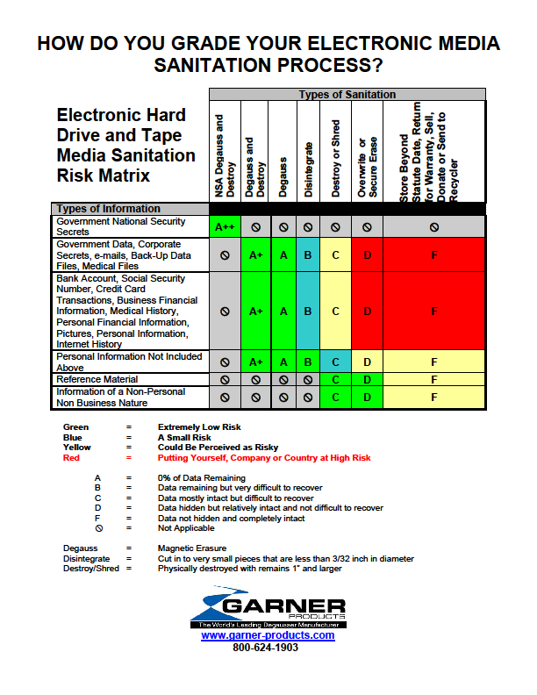

Slide 8
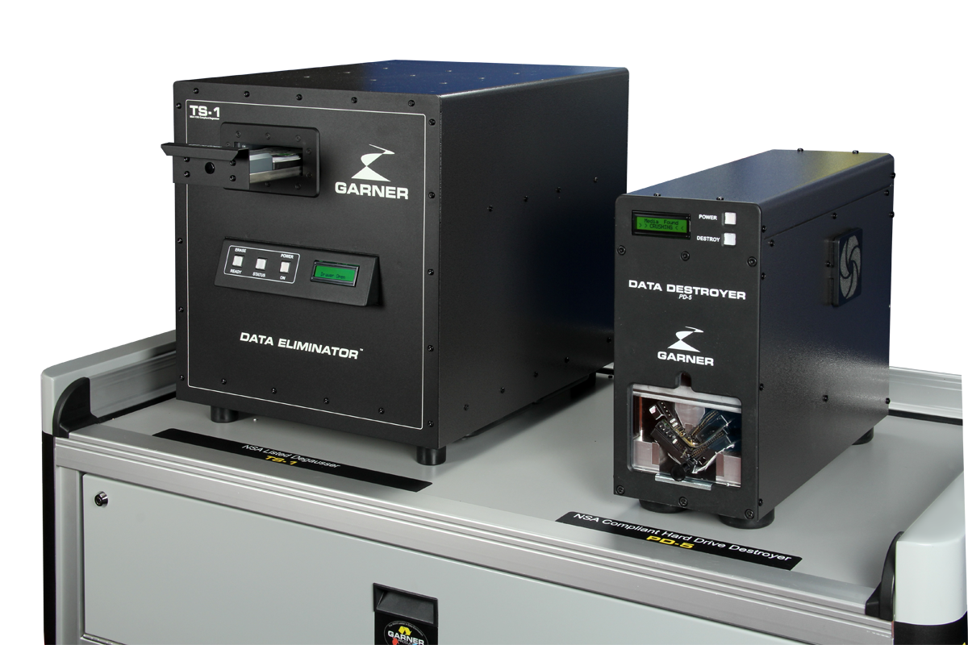

Data Destruction Methods
Overwrite/Secure Erase
Shred or Bend
Degauss

Slide 9
Overwriting/Secure Erase
Only adds layers to existing data.
Information is still there until new data is completely filling the drive.
Requires technical expertise and supervision of process.
Disk drive must be in perfect working order, i.e. damaged parts of the disk will still have information but cannot be overwritten.
Nearly five times the cost of degaussing.
How do you know it is actually happening? Software and even firmware is your enemy.
Recovery happens from overwritten drives. Does your company want to be associated with the breach of even one customer file?
Cost to Overwrite 1,000 Drives
Overwrite/Secure Erase requires 3-21 Hrs. Per Drive
4000 technician hours = $260,000.00
Drives overwritten = 1,000.00
Value of drives saved = $ 20,000.00
Cost $240,000.00
Cost to Degauss 1,000 Drives
HD-3WXL Degausser processes 300 Drives Per Hr.
3 Technician hours to degauss = $195.00
Number of Drives Degaussed = 1,000.00
Cost of new replacement drives = $40,000.00
Cost of degausser = $ 9,000.00
Cost $49,195.00

Slide 10
Overwriting/Secure Erase
KROLL Ontrack--"SSD erasure will invariably leave about 10% of the data recoverable despite subjecting it to a DoD standard erasure” Adrian said. Format and deletion of the partition is no barrier to almost full recovery and currently most SSD’s require chips to be crushed to be sure.
Other Data Recovery Companies—”Basic recovery from over-written drives comes from sectors that the drive designated as “Bad” and will not write to. Transferring the platters to a new drive with optimized read/write heads will recover data written to bad sectors”
Backblaze's 2014 Study of hard drive failures in data centers concluded that the failure rate is around 5% among the three major brands of hard drives. FAILED HARD DRIVES OR SSD’s CANNOT BE OVERWRITTEN.

Slide 11
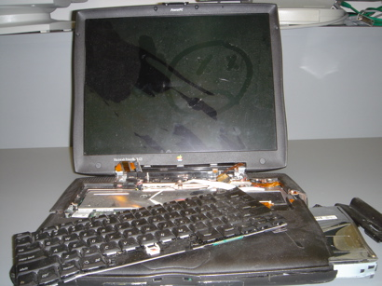
Basic Physical Destruction
1. Drilling holes, hitting with a hammer, running over with a truck etc. will not get rid of data. It will only make it more difficult to recover. www.drivesavers.com
2. Check out the website and see the data that they have recovered. Very enlightening.

Slide 12
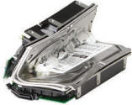
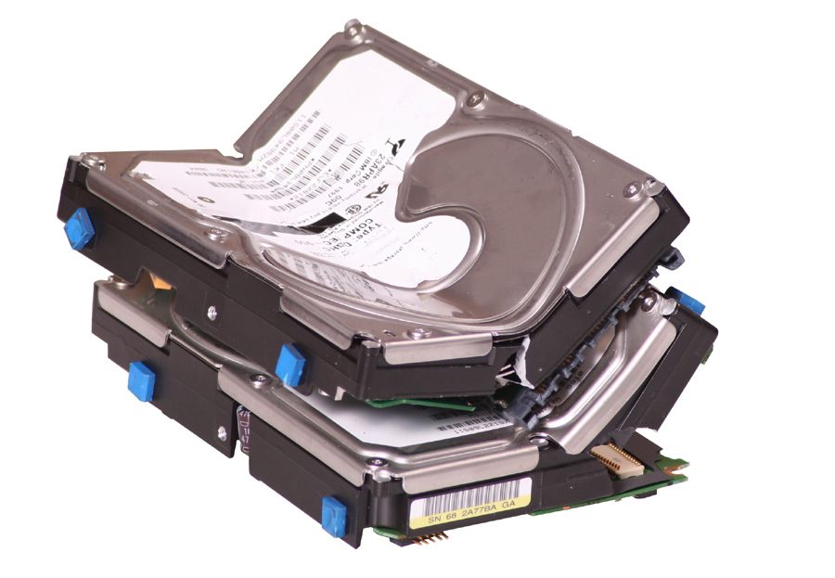
Shred and Bend
Data is still present but difficult to recover. However, new magnetic data organization techniques and exponential growth in density increase the potential of recovery.

Slide 13
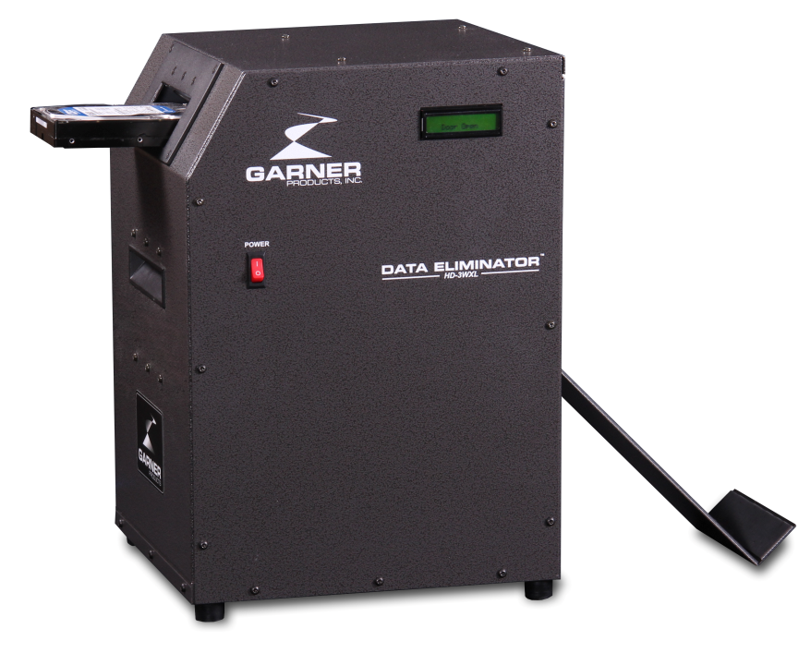
Degaussing
0% chance of recovery
The most widely accepted high security method of disposal

Slide 14
Degaussing is Permanent
Modern hard drives have changed little in the last 5 years.
A degausser with sufficient field strength will make data stored on hard drive platters unrecoverable by any means.
The magnetic particles are completely randomized and there is no partial orientations of magnetic alignments.
Garner commercial degausser and NSA listed degaussers all eliminate data. NSA listed degaussers offer significantly more margin for error or changes in technology.

Slide 15
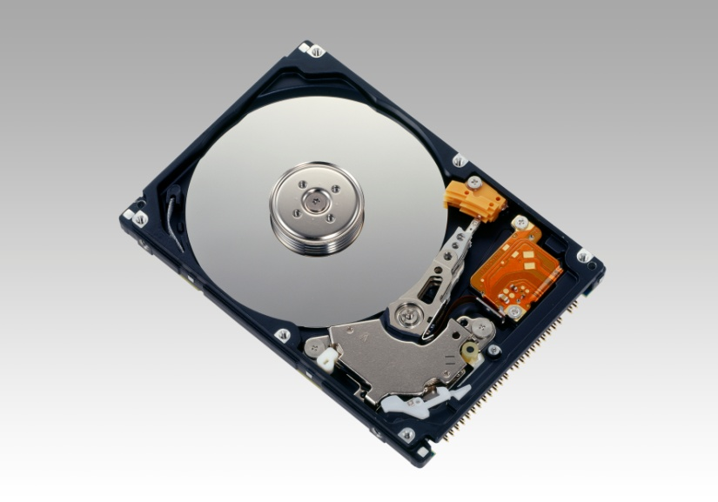
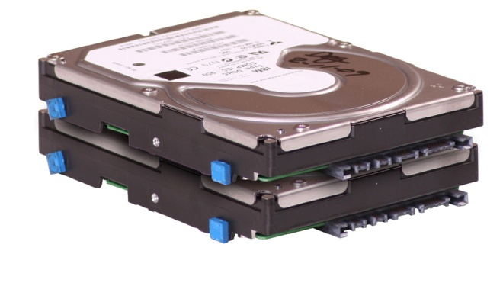
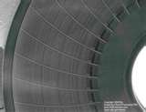
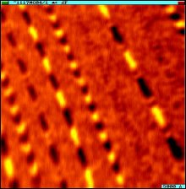
Anatomy of a Hard Disk Drive

Slide 16
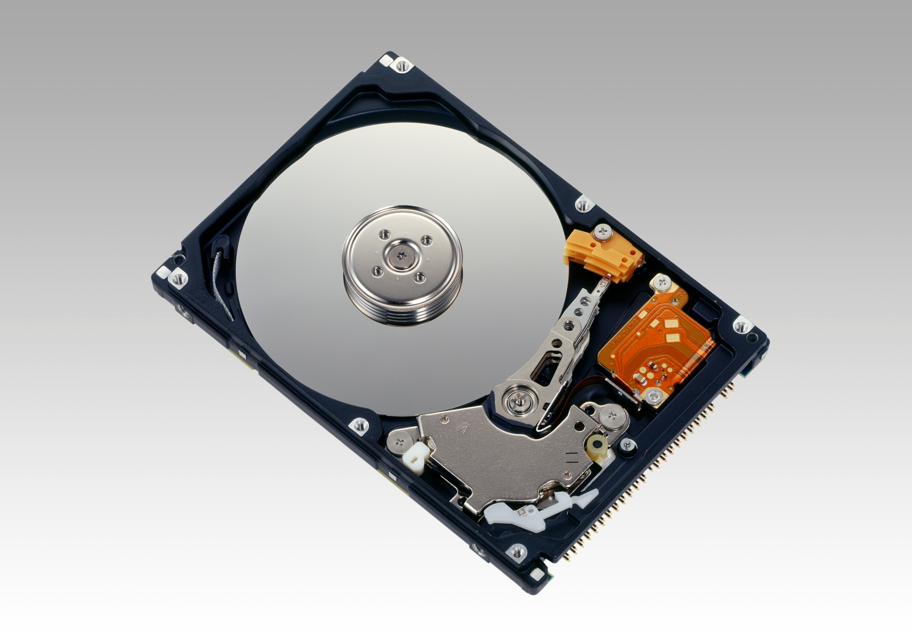
Inside a Hard Drive
Drive Hub/Motor
Drive Platters
Read/Write Magnet
Read/Write Head

Slide 17
Inside the Platter
Long view of Platter under magnetic microscope
Servo Tracks
Microscopic view of data laid down within servo track area

Slide 18
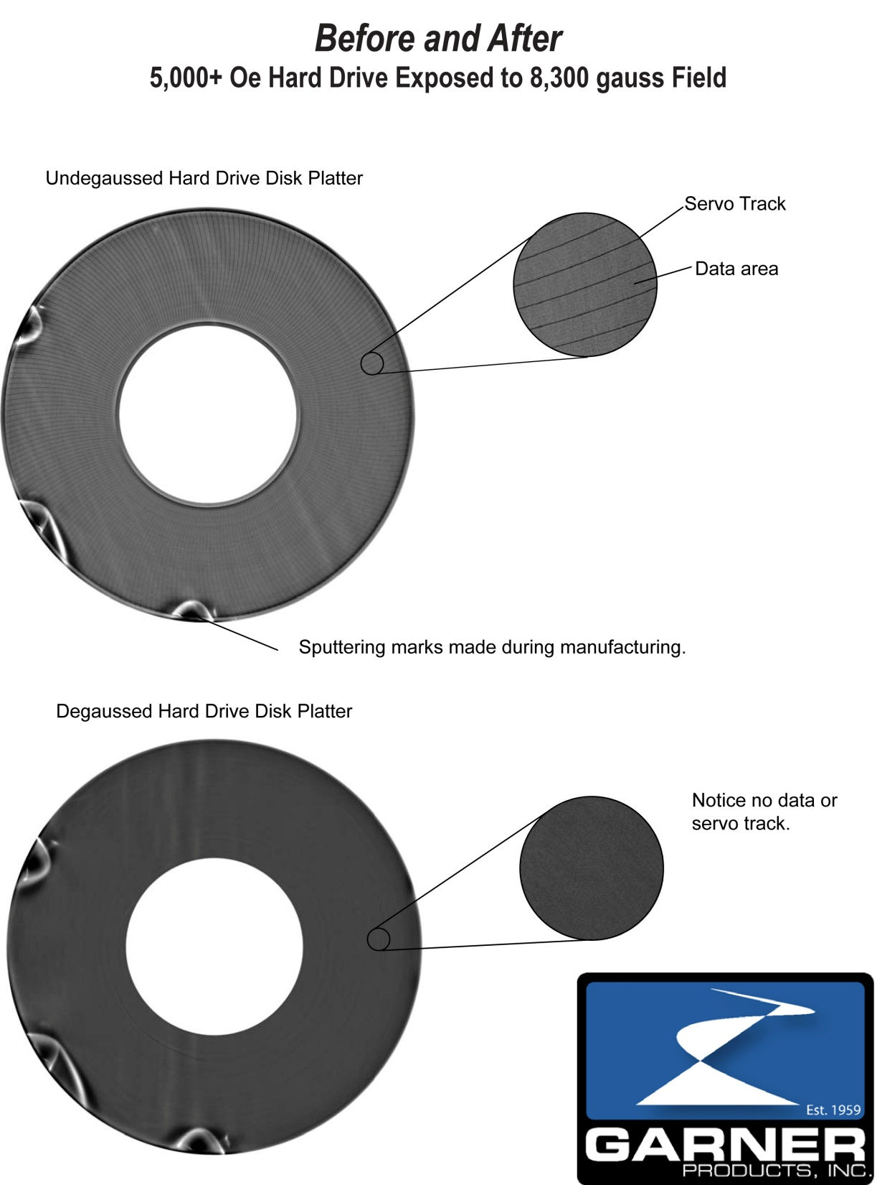

Slide 19
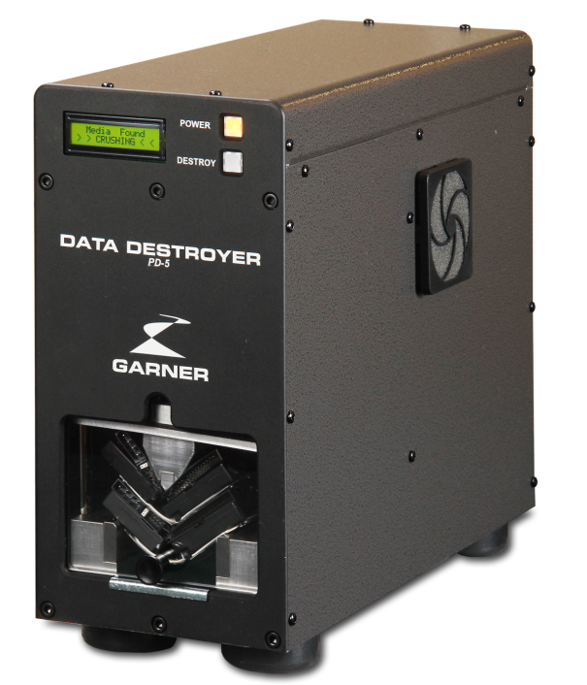
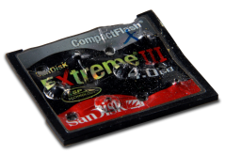
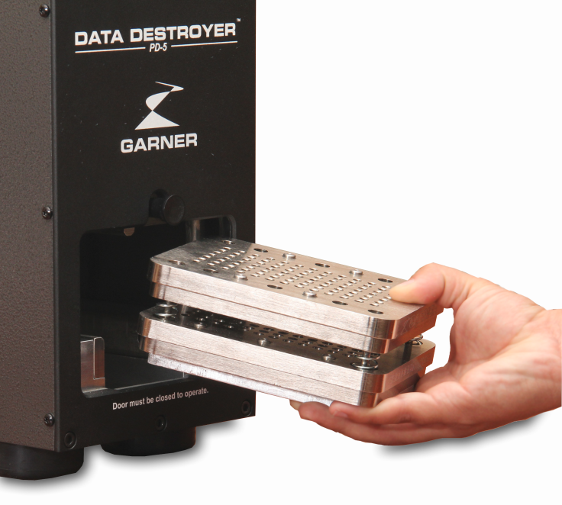

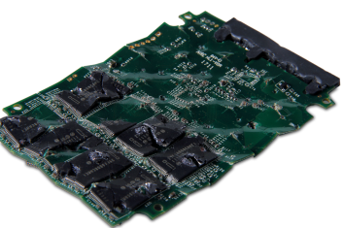
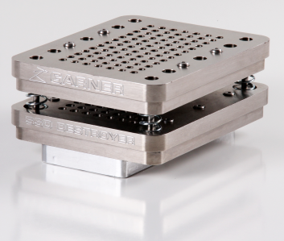
SSD Destruction
PD-5 with SSD-1 attachment completely
eliminates data from solid state media

Slide 20

Why Garner?
Worldwide Support
In business since 1959
Most tested brand
Full line manufacturer
Best build quality
Best support
Continuous innovation

Slide 21
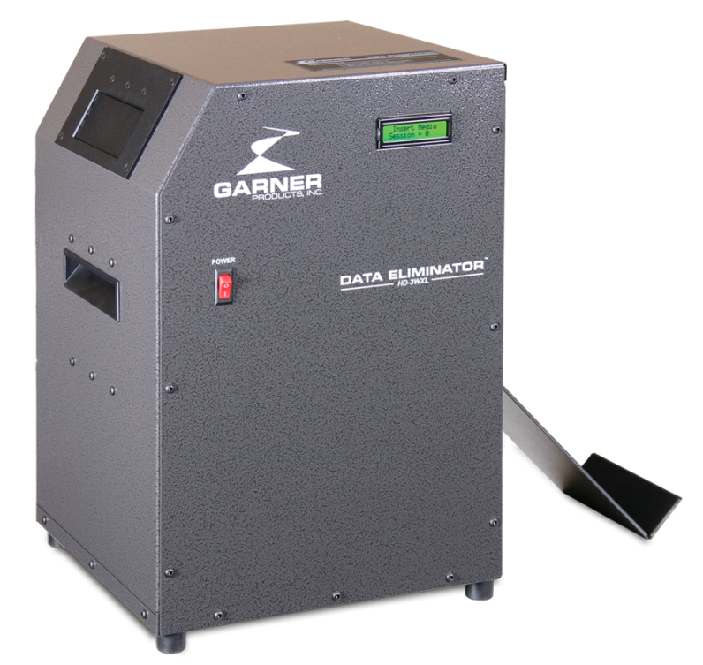
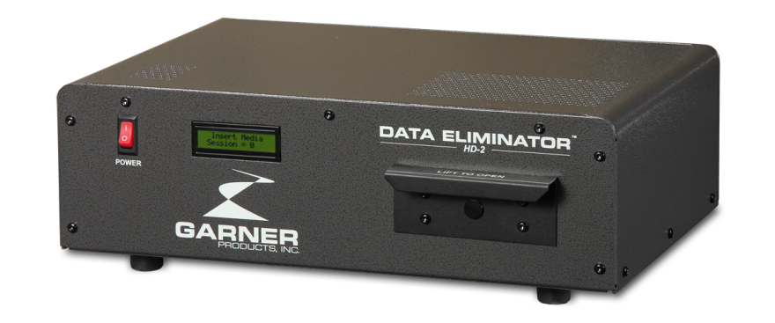

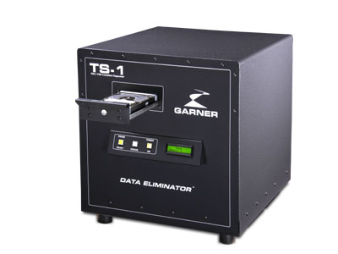
Full Line Data Elimination
HD-2
TS-1
HD-3WXL
PD-5

